Slide 1
Database vs. Traditional File System
2

Slide 2
Today’s Agenda
Traditional file accessing approach
Organization of traditional file system
Characteristics of File Processing System
Limitations of the File Processing System
Advantages of DBMS
Disadvantages of DBMS

Slide 4
Traditional file accessing approach
File processing systems was an early attempt to computerize the manual filing system that we all are familiar with. A file system is a method for storing and organizing computer files and the data they contain to make it easy to find and access them. File systems may be used as a storage device such as a hard disk or CD-ROM and involve maintaining the physical location of the files.

Slide 5
Traditional file accessing approach
In our own home, we probably have some sort of filing system, which contains receipts, guarantees, invoices, bank statements, and such like. When we need to look something up, we go to the filing system and search through the system starting from the first entry until we find what we want. Alternatively, we may have an indexing system that helps to locate what we want more quickly. For example we may have divisions in the filing system or separate folders for different types of item that are in some way logically related.

Slide 6
Traditional file accessing approach
The manual filing system works well when the number of items to be stored is small. It even works quite adequately when there are large numbers of items and we have only to store and retrieve them. However, the manual filing system breaks down when we have to cross-reference or process the information in the files. For example, a typical real estate agent’s office might have a separate file for each property for sale or rent, each potential buyer and renter, and each member of staff.

Slide 7
Traditional file accessing approach
Clearly the manual system is inadequate for this’ type of work. The file based system was developed in response to the needs of industry for more efficient data access. In early processing systems, an organization’s information was stored as groups of records in separate files.
In the traditional approach, we used to store information in flat files which are maintained by the file system under the operating system’s control. Here, flat files are files containing records having no structured relationship among them. The file handling which we learn under C/C ++ is the example of file processing system. The Application programs written in C/C ++ like programming languages go through the file system to access these flat files.

Slide 8
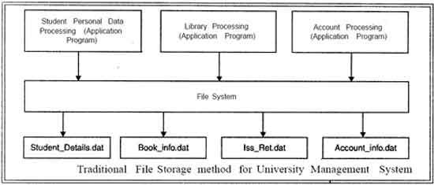
Traditional file accessing approach

Slide 9
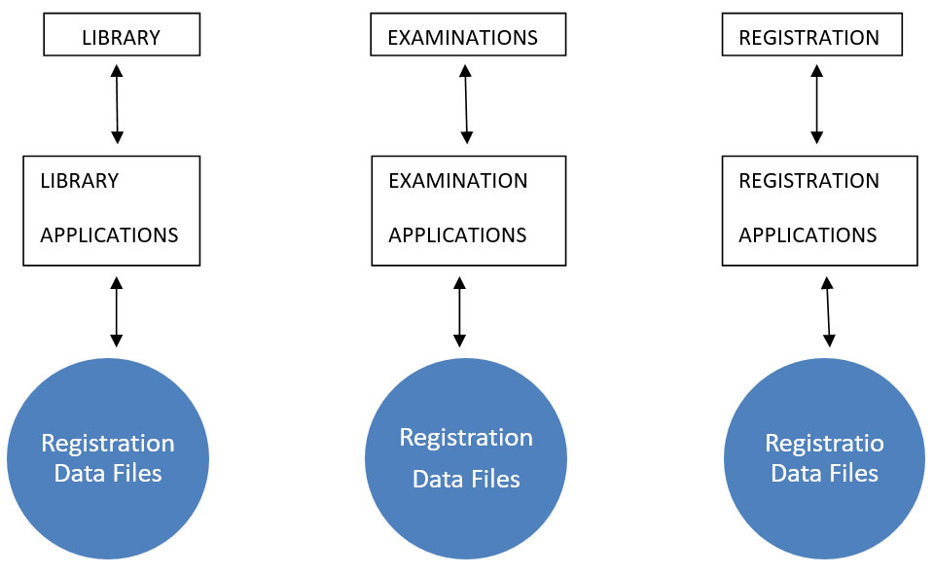
Traditional file accessing approach

Slide 10
Organization of traditional file system
Traditional databases are organized in field, record and data files.
Field: Individual element of data is called field. Example: Bank cheque consists of fields like: cheque no., date, signature, bank name etc.
Records: It is a collection of related items of data that are treated as a unit. Example: An employee record would be a collection of all field of any employee.
Data File: It is a number of related records that are treated as unit. Example: A collection of all employee records for one company would be an employee file.

Slide 11
Characteristics of File Processing System
• It is a group of files storing data of an organization.
• Each file is independent from one another.
• Each file is called a flat file.
• Each file contained and processed information for one specific function, such as accounting or inventory.
• Files are designed by using programs written in programming languages such as COBOL, C, C++.
• The physical implementation and access procedures are written into database application; therefore, physical changes resulted in intensive rework on the part of the programmer.
• As systems became more complex, file processing systems offered little flexibility, presented many limitations, and were difficult to maintain.

Slide 12
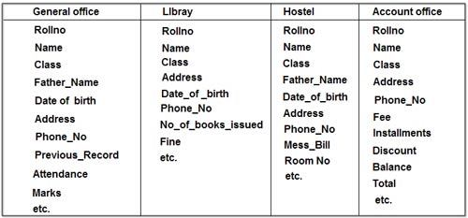
Limitations of the File Processing System I File-Based Approach

Slide 13
Limitations of the File Processing System I File-Based Approach
Redundancy or duplication of data
Often the same information is stored in more than one file. Uncontrolled duplication of data is not required for several reasons, such as:
Duplication is wasteful. It costs time and money to enter the data more than once
It takes up additional storage space, again with associated costs

Slide 14
Limitations of the File Processing System I File-Based Approach
Separated and Isolated Data: To make a decision, a user might need data from two separate files. First, the files were evaluated by analysts and programmers to determine the specific data required from each file and the relationships between the data and then applications could be written in a programming language to process and extract the needed data. Imagine the work involved if data from several files was needed.

Slide 15
Limitations of the File Processing System I File-Based Approach
Data Dependency: In file processing systems, files and records were described by specific physical formats that were coded into the application program by programmers. If the format of a certain record was changed, the code in each file containing that format must be updated. Furthermore, instructions for data storage and access were written into the application’s code. Therefore, changes in storage structure or access methods could greatly affect the processing or results of an application.
In other words, in file based approach application programs are data dependent. It means that, with the change in the physical representation (how the data is physically represented in disk) or access technique (how it is physically accessed) of data, application programs are also affected and needs modification. In other words application programs are dependent on the how the data is physically stored and accessed.

Slide 16
Limitations of the File Processing System I File-Based Approach
Difficulty in representing data from the user’s view: To create useful applications for the user, often data from various files must be combined. In file processing it was difficult to determine relationships between isolated data in order to meet user requirements.

Slide 17
Limitations of the File Processing System I File-Based Approach
Data Inflexibility: Program-data inter dependency and data isolation, limited the flexibility of file processing systems in providing users with ad-hoc information requests

Slide 18
Limitations of the File Processing System I File-Based Approach
Incompatible file formats: As the structure of files is embedded in the application programs, the structures are dependent on the application programming language. For example, the structure of a file generated by a COBOL program may be different from the structure of a file generated by a ‘C’ program. The direct incompatibility of such files makes them difficult to process jointly.

Slide 19
Limitations of the File Processing System I File-Based Approach
Data Security. The security of data is low in file based system because, the data is maintained in the flat file(s) is easily accessible. For Example: Consider the Banking System. The Customer Transaction file has details about the total available balance of all customers. A Customer wants information about his account balance. In a file system it is difficult to give the Customer access to only his data in the· file. Thus enforcing security constraints for the entire file or for certain data items are difficult.

Slide 20
Limitations of the File Processing System I File-Based Approach
Transactional Problems. The File based system approach does not satisfy transaction properties like Atomicity, Consistency, Isolation and Durability properties commonly known as ACID properties.
For example: Suppose, in a banking system, a transaction that transfers Rs. 1000 from account A to account B with initial values’ of A and B being Rs. 5000 and Rs. 10000 respectively. If a system crash occurred after the withdrawal of Rs. 1000 from account A, but before depositing of amount in account B, it will result an inconsistent state of the system. It means that the transactions should not execute partially but wholly. This concept is known as Atomicity of a transaction (either 0% or 100% of transaction). It is difficult to achieve this property in a file based system.

Slide 21
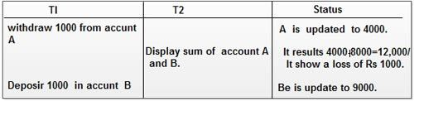
Limitations of the File Processing System I File-Based Approach
Concurrency problems. When multiple users access the same piece of data at same interval of time then it is called as concurrency of the system. When two or more users read the data simultaneously there is a problem, but when they like to update a file simultaneously, it may result in a problem.
Let us consider a scenario where a transaction T1 wants to transfers an amount 1000 from Account A to B (initial value of A is 5000 and B is 8000). In mean while, another transaction T2, tries to display the sum of account A and B is also executed. If both the transaction runs in parallel it may results inconsistency as shown below:

Slide 22
Limitations of the File Processing System I File-Based Approach
Poor data modeling of real world. The file based system is not able to represent the complex data and interfile relationships, which results poor data modeling properties.

Slide 23
Advantages of DBMS
Reduction of redundancies
consistency
Propagating updates is easier
Accessing data is easier through DBMS
Shared data
Integrity can be maintained
Atomicity
Conflicting requirements can be balanced
Standards can be enforced
Security restrictions can be enforced

Slide 24
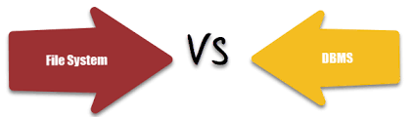
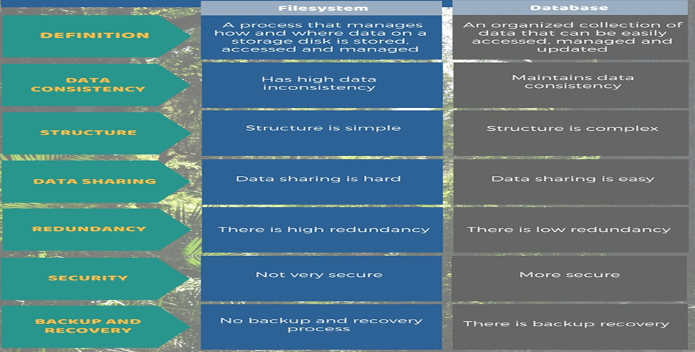

Slide 25
Disadvantages of DBMS
Cost
Complexity
Danger of a overkill
Qualified professional
Lower efficiency

Slide 26
Need of database
Compactness
Speed
Accuracy
Relevancy

Slide 27
Questions
What are the elements of a database?
List eight significant differences between file processing system and DBMS.
What is DBMS? Explain its function.
List five database system applications.
What is atomicity and integrity?
What are the advantages of using a database system?
ABC is a software company involved in a software design. ABC CEO wants to design a database that store the information about the software dealing between the companies, its products and their costs. Explain the major steps to maintain the data secure and consistent.

Slide 28


